Slide 1
ETSI 004
Madrid Example

Slide 2
How is it set up
TCP Socket
Alice
Encrypted messages
Bob
encrypt(), decrypt(), get_key(), get_key_bytes()
encrypt(), decrypt(), get_key(), get_key_bytes()
Application class
Application class
open_connect(), get_key(), close()
open_connect(), get_key(), close()
Application driver
Application driver
TCP Socket
TCP Socket
LKMS node 1
LKMS node 2
Bitstream
Bitstream
Random number generator
Random number generator
Same seed !

Slide 3
How does it work

Slide 4

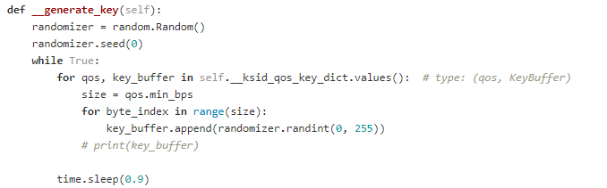
Random number generator
Periodically add a key to the buffer (every 0.9 seconds)
Same seed -> same key

Slide 5
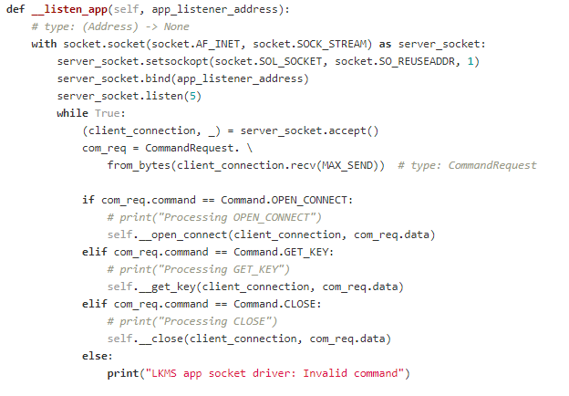
LKMS
Spawns thread with socket listener
Answers API calls
Also spawns thread with key generator
The keys are stored in the LKMS class (not accessible anywhere else)

Slide 6
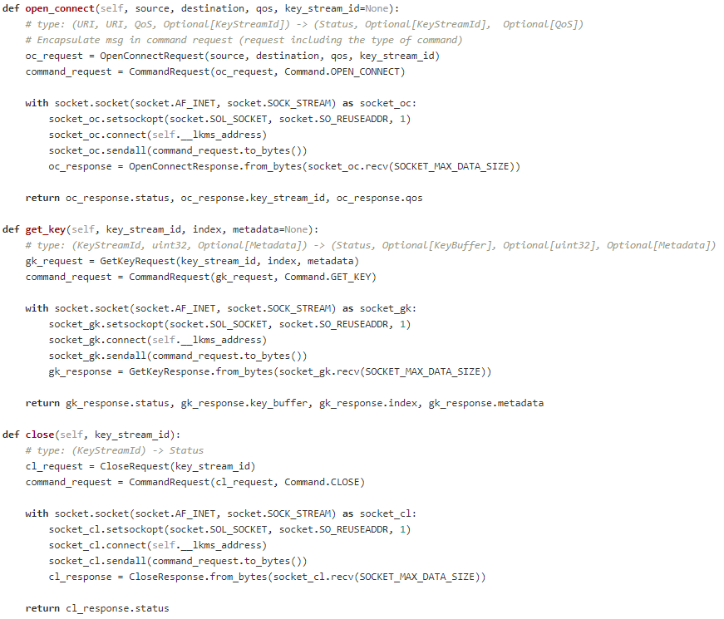
Application driver
Translates the API calls with python variables to a TCP packet

Slide 7
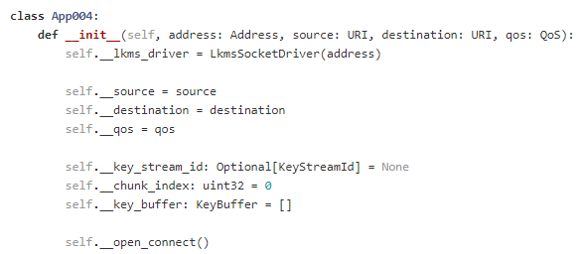
Application class
Abstracts the programmer from the API calls
Allows the programmer to directly encrypt/decrypt his messages or get the key bytes

Slide 8
Implementing raw keys
We can implement raw keys by having an input parameter for key error in the open_connect api call
An error percentage gets associated with the Key Stream ID
This way there is no need to have two key management systems, only one that can distribute both raw and symmetric keys

Slide 9
How is it set up
TCP Socket
Alice
Encrypted messages
Bob
encrypt(), decrypt(), get_key(), get_key_bytes()
encrypt(), decrypt(), get_key(), get_key_bytes()
Application class
Application class
open_connect(), get_key(), close()
open_connect(), get_key(), close()
Application driver
Application driver
TCP Socket
TCP Socket
LKMS node 1
LKMS node 2
Bitstream
Bitstream
Random number generator
Random number generator
Same seed !

Slide 10
Alice
OPEN_CONNECT(in source, in destination, inout QoS,
inout Key_stream_ID, in error_chance, out status)
Key Manager
error_chance
raw_key / symmetric_key
Random Number Generator

Slide 11
Examples

Slide 12
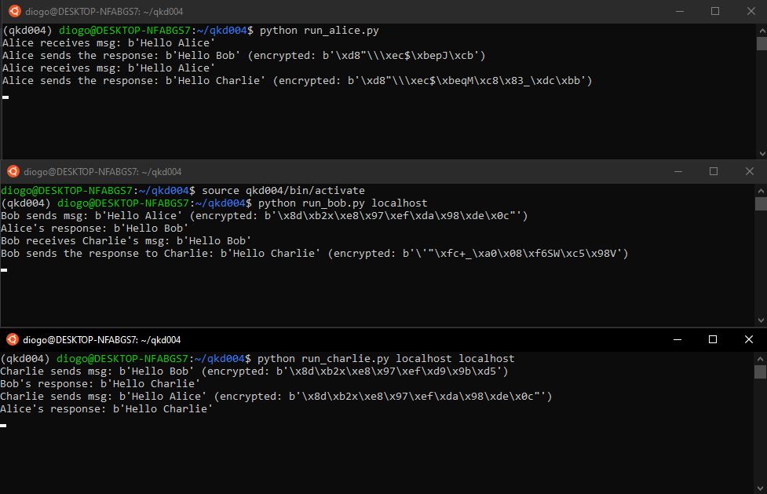

Slide 13
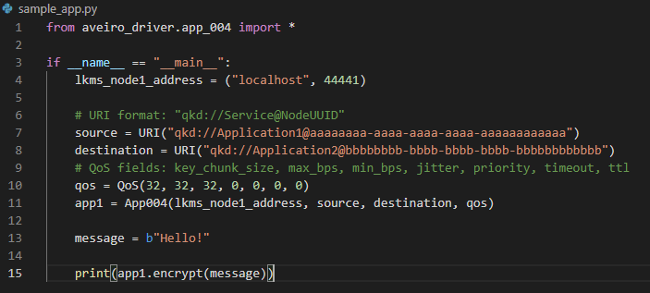
Encrypting a message

Slide 14
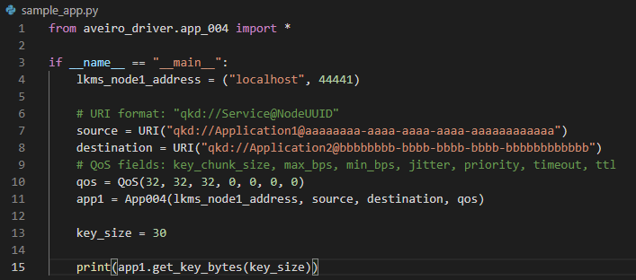
Getting keys

